Slide 1
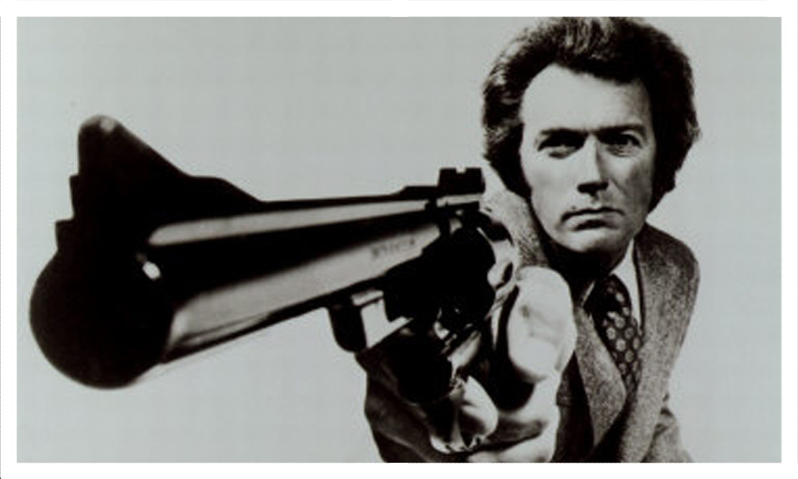
Business Intelligence Assignment
IS6833 – Sauter – Spring 2012
Kuo-Luen (Alan) Chang
Curt Rozycki
Kristopher Turner

Slide 2
Proposal (Utilize BI to solve Violent Crime in STL)
Neighborhood demographic data could warehoused
Then mined for trends linking neighborhood demographics to probability for violent crime
Use characteristics of specific crimes to extract data trends

Slide 3
Example Decisions supported by BI
How to allocate resources
What neighborhoods to have greatest police presence a. officers b. sub-stations
Where to fund youth programs

Slide 4
Data utilized and managed
Census data
Homicide data
Other violent crime
Fire arms
Number people who rent versus own
Occupation of residents

Slide 5
Dashboards
Virtual map showing number of violent crimes by neighborhood
Number of residents with a criminal record
Include repeat offenders
Include nature of crime

Slide 6
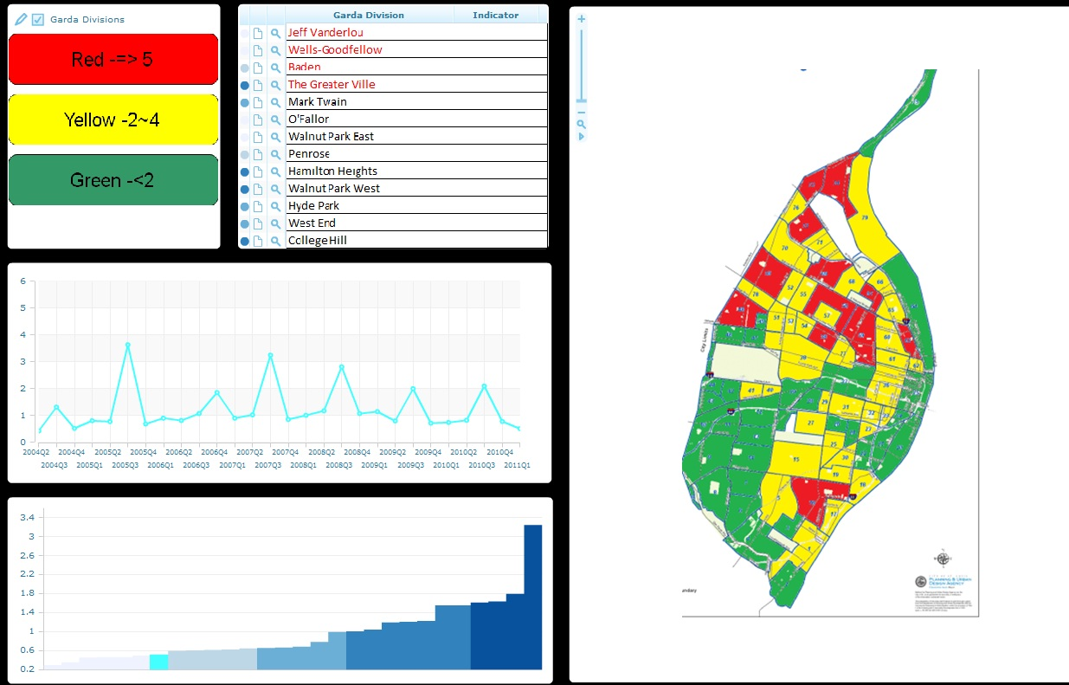
Dashboard Example

Slide 7
Specific analytics Provided
Individual neighborhood reports
Reports showing virtual map of exact crime locations
Maps with color codes for neighborhood red = dangerous, orange = at risk, green = good
Real time crime indicator
Smart phone app for crime "real time"

Slide 8
Low Crime Benefits
Attracts more residents
Healthier and happier
Less stress, more security
Attracts new businesses
Increases Property Value
Decrease Tax Inflation
Less crime, less jails and prisons
Less hospital visits
Lower insurance rates in low risk environments

Slide 9
Barriers
Expensive to implement software
Expensive to train Police force
Expensive to analyze and collect data
STL pop. = 356,587 x $42.11 = $15mil
Census Year | Total Population | Census Cost | Average Cost per Person
1970 | 203,302,031 | $247,653,000 | $1.22
1980 | 226,542,199 | $1,078,488,000 | $4.76
1990 | 248,718,301 | $2,492,830,000 | $10.02
2000 | 281,421,906 | $4.5 Billion | $15.99
2010* | 308,745,538 | $13 Billion | $42.11

Slide 10
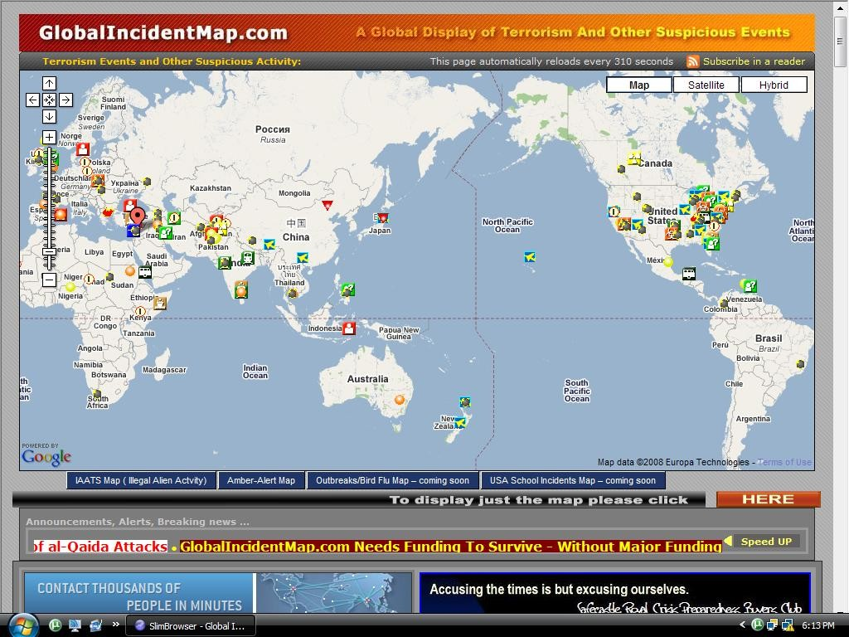
Dashboard Ex. Global Incident Map
http://www.globalincidentmap.com/

